Slide 1
Lecture 6 – The Design Process and Key Development Milestones

Slide 2
Warning
This material may create drowsiness. Machinery and other equipment should not be operated while under the influence of this material
Seriously
  Every organization has different procedures
  The idea of this briefing is to capture the generally accepted practices that are critical to an organized design process in any organization
I have tried to make this interesting and amusing but it is very hard to find ways to visualize about how to conduct design reviews

Slide 3
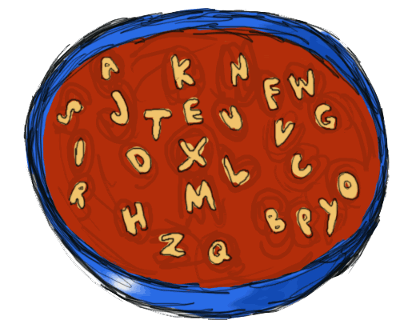
Development Milestones
System Requirements Review (SRR)
System Design Review (SDR)
Preliminary Design Review (PDR)
Critical Design Review (CDR)
Manufacturing Readiness Review (MRR)
Test Readiness Review (TRR)
First Article Configuration Inspection (FACI)/Physical Configuration Inspection (PCI)
Design Certification Review (DCR)
Flight Readiness Review (FRR)
Notes:
This looks daunting, but it actually makes some sense when you work through it. The trick is to get the real value out of these reviews and not get lost in the forest of activities. These reviews take time and focus and if you conduct them improperly you can end up with a worse project performance.
It is important to realize that the purpose of the reviews is not to achieve a milestone but rather to make visible those things which will impede success unless they are fixed.

Slide 4
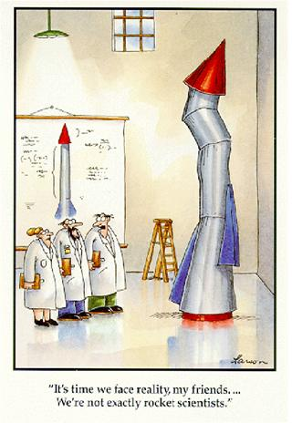
Review Flow
System Requirements Review
System Design Review
One PDR and CDR for each major component or subsystem. You may also have an “integrated” PDR and CDR
Preliminary Design Review(s)
Critical Design Review(s)
Manufacturing Readiness Review
Test Readiness Review
First Article Configuration Inspection
Design Certification Review
Operational Readiness Review
Notes:
Seeing the reviews in a time ordered flow makes a little more sense. For example it makes sense to do a preliminary design review before a critical design review. It makes sense to review your manufacturing readiness only after the design is complete.

Slide 5
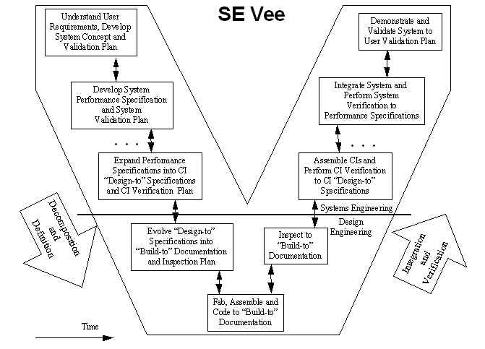
Reviews and System Integration
FRR
SRR
DCR
SDR
FACI
PDR
TRR
CDR
MRR
Notes:
This all ties into the VEE. Each of the steps in the VEE corresponds to a review activity. Whether the review is a big activity involving hundreds of people or just a few people talking about a conference table, each of these steps in the VEE usually terminates a some sort of discussion where the status is reviewed.

Slide 6
Entry and Exit Criteria/Deliverables
At the start of planning for a review you should establish the entry and exit criteria for the review
Deliverables are products that are the result of the design process. They may be documents, simulation models, analyses, prototypes or production hardware
Entry criteria are the conditions and deliverables necessary before a review can start
  Typical entry criteria involve
    Required documents completed and distributed for comments
    Comments on documents received and reviewed
    Analyses complete, prototype tests completed, mockups or prototypes evaluated
    Issues resolved from previous review or open issues identified as not a constraint to review
Exit criteria are those conditions that must be present for the review to complete
  Typical exit criteria
    All presentations complete
    All issues raised during the review are closed or documented if they are still open
    Open issues classified as constraint/no constraint to proceeding ahead
    Forward resolution plan identified for all open issues
    Review board members sign off on review as complete

Slide 7
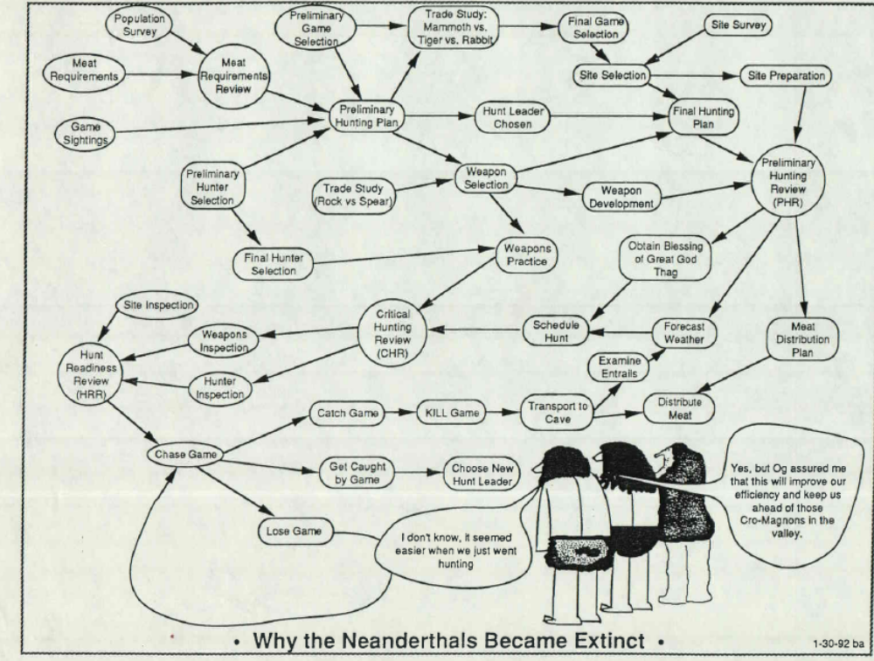
Notes:
I particularly like this cartoon because it shows what becomes the undoing of many projects. Oftentimes projects or programs become obsessed with the mechanics of documents and reviews with the result that progress on the actual project is compromised.

Slide 8
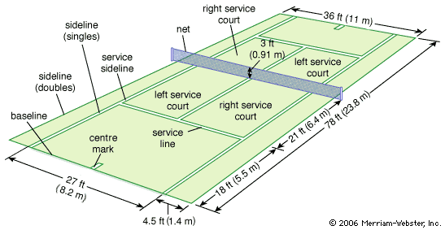
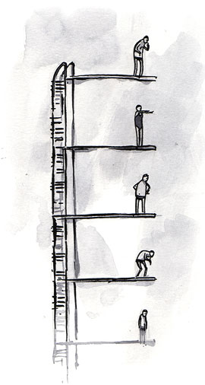
Baseline
Term used to describe elements of a project that are
  Published
  Reviewed and approved
  under change control – they cannot be changed unless approved by the change authority
    Changes are usually proposed to a change control board (normally hosted by the program/project manager) where the technical merits of a change, as well as its cost and budget implications are discussed
Items can be baselined while issues still exist
Baseline simply states the current status of the program/project so that all elements can proceed from a common point
It is important to carefully consider how you keep baseline changes coordinated among multiple elements so that all parts of the project are working from a consistent state (starting point)
http://www.britannica.com
www.alistapart.com
Notes:
Baselining is an important term in performing system reviews. The idea is to get everyone on the same level so that their efforts are coordinated,
It is a bit of an obscure term, but it is used universally.
When you baseline something, basically you say that this document or product should be used by everyone in the project. It keeps everyone working together.

Slide 9
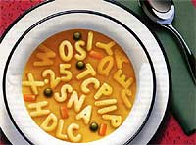
System Requirements Review (SRR)
Objective – To determine that the top level system requirements are complete and valid
Minimum Entry Criteria – A baselined system requirements document
Minimum Exit Criteria –
  a revised system requirements document incorporating changes
  A list of open issues
  A resolution plan for each open issue with responsible party identified for each issue
  An evaluation if any of the open issues constrains forward work of the project/program
  Concurrence of the board members for the review
Once the SRR is complete- subsequent reviews are NOT about changing the requirements
  If requirements issues become visible as the design progresses, a special meeting (typically at a requirements control board) should be held
  Design reviews should not be used for requirements debates
Notes:
The important thing about the SRR is that it establishes a baseline of the requirements. It is the only time you should really been reviewing the requirements in a program or project. After that, the program or project should be about executing the design and assembly of the product per the requirements.
Having said that, it is not unusual that as design progresses, that people begin to better understand requirements or find that they need to “challenge” the requirements to see if they are valid. These discussions need to be OUTSIDE of the design review process. You can’t keep changing the requirements as part of the design process.
Now it is necessary to be able to change requirements. When you think you need to change requirements, you need to hold a meeting with all of the affected parties and agree to the requirements change. The change needs to be communicated across the program or project. Then you can go back into the design process.
If you are having a design review and find yourself in a requirements discussion, you should continue the design review according to the current requirements and agree to hold a meeting regarding the requirements after the design review. If the requirements issue is so large that it doesn’t make sense to continue the design review, you should put the design review on hold while you resolve the requirements and then go back into the design review.

Slide 10
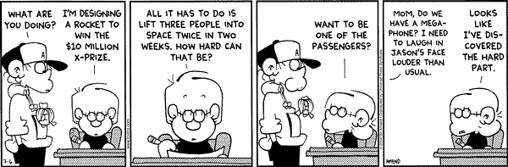
System Design Review (SDR)
Objective : To determine if the top level design is sound and adequate
  Secondary objective – to determine if all requirements have been decomposed and allocated to subsystems
Minimum Entry Criteria
  Top level system design documentation released for review
  Top level verification plan identifying verification method for each major requirement
Minimum Exit Criteria
  revised system design documents incorporating changes
  A list of open issues
  A resolution plan for each open issue with responsible party identified for each issue
  An evaluation if any of the open issues constrains forward work of the project/program
  Concurrence of the board members for the review
Notes:
At the SDR you should be determining that the system level design is adequate and that every system requirement has been distributed and allocated as requirements on the subsystems. Some requirements like the operating environment are allocated to ever subsystem. Other requirements may only be allocated to a single subsystem.
The entry and exit criteria will be very similar for the multiple reviews. To enter a review, all of the appropriate documents must be completed and distributed to the parties involved in the review.
The exit criteria should include revised documents, a list of the open issues, a plan to resolve each of the open issues (so they don’t just sit around) and an evaluation that the open issues won’t prevent further progress. If the open issues will prevent further progress, it is time to address them. Normally a board is convened to supervise the review. The board consists of knowledgeable people from the major stakeholders in the project.
I love this Foxtrot cartoon. Jason has decided to compete for the XPrize, which was the competition to launch a commercial human spacecraft to greater than 100 Nmiles. The actual prize was won by Burt Rutan and Paul Allen with their Starship One. But in the cartoon is a clear statement of the requirement: lift three people into space twice in two weeks

Slide 11
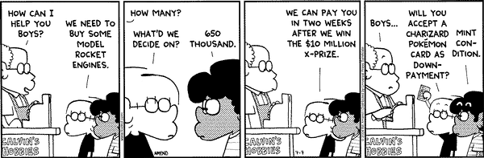
Preliminary Design Review (PDR)
Objective : To review the preliminary design for the integrated system or for major subsystems or components
Minimum Entry criteria
  An estimate of total design effort required to complete the design (number of parts, number of drawings, numbers of lines of code)
  Selection of major design concept, conclusion of major design trades
  Design drawings, schematics or other design documentation – generally 10% of drawings complete
  Supporting analyses predicting performance, and showing that product is within all technical budgets (power, weight, etc…)
  Trace showing how allocated requirements are met by the design
  A preliminary verification plan
Minimum Exit Criteria
  revised system design documents incorporating changes
  A list of open issues
  A resolution plan for each open issue with responsible party identified for each issue
  An evaluation if any of the open issues constrains forward work of the project/program
  Concurrence of the board members for the review
Notes:
Here the boys (Jason and Marcus) have decided on a design concept just as you should in a preliminary design review. They have decided on using model rocket engines. This should bring a smile to anyone who has ever played with model rockets and who has also undoubtedly calculated how many model rocket engines it would take to launch a person (or was I the only one geeky enough to do that ?). This type of “does it make sense” calculation is the exact type of thing that should be done at a PDR. Also the boys are beginning to struggle with the issue of whether their design fits into the budget, another key issue at a PDR.

Slide 12
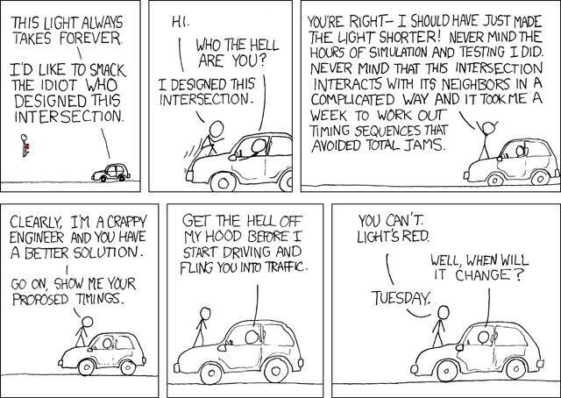
Critical Design Review (CDR)
Objective : To review the preliminary design for the integrated system or for major subsystems or components
Minimum Entry criteria
  An updated estimate of total design effort required to complete the design (number of parts, number of drawings, numbers of lines of code)
  Detailed design complete, all major trade selections complete
  Design drawings, schematics or other design documentation – generally 90% of drawings complete
  Supporting analyses predicting performance, and showing that product is within all technical budgets (power, weight, etc…) – protoype and initial test results
  Trace showing how allocated requirements are met by the design
  A final verification plan
Minimum Exit Criteria
  revised system design documents incorporating changes
  A list of open issues
  A resolution plan for each open issue with responsible party identified for each issue
  An evaluation if any of the open issues constrains forward work of the project/program
  Concurrence of the board members for the review
Notes:
I highly recommend www.xkcd.com as a source for technology cartoons. Occasionally there is some offensive material but they are largely witty and to the point.
The point I am trying to make with the engineer on the hood of the car is that the CDR is where all your analyses that say a design will meet requirements should come together.

Slide 13
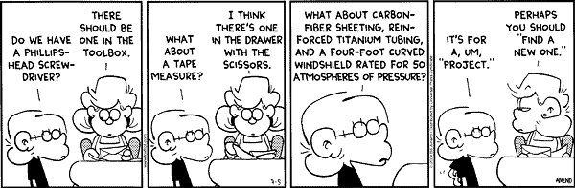
Manufacturing Readiness Review (MRR)
Objective : To determine if the program/project is ready to start manufacturing
Minimum entry criteria
  Drawings complete
  Tooling and assembly jigs complete
  Certified sources if material identified
  Processes and personnel certified to perform manufacturing
  Fasteners and connectors identified – real concern about counterfeit fasteners and connectors can be very long lead
  Baselined Manufacturing Plan
Minimum Exit Criteria
  revised manufacturing plan
  A list of open issues
  A resolution plan for each open issue with responsible party identified for each issue
  An evaluation if any of the open issues constrains forward work of the project/program
  Concurrence of the board members for the review
Notes:
A manufacturing readiness review should determine if you are ready to start building a product. You need to know that you have design documentation, access to materials, approved processes for manipulating materials (such as welding, riveting, and soldering), quality inspection as well as tooling and a plan on how to build it.
I love that in this cartoon, Jason asks for tools (a screwdriver), a quality inspection (tape measure) and then materials (carbon-fiber sheeting, reinforced titanium tubing and a four foot curved windshield rated for 50 atmospheres of pressure)

Slide 14
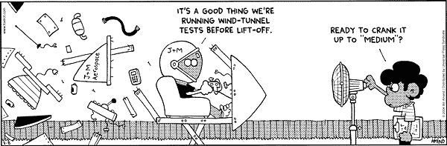
Test Readiness Review (TRR)
Objective : To determine if the program/project and test organization/test facility are ready to start a test
Minimum entry criteria
  Test requirements baselined
  Test plan and procedures baselined
  Support facilities including modified facilities, lifting fixtures, instrumentation and data acquisition software are complete and ready to support
  Hazard analysis performed and critical hazards controlled
  Critical limits and go-no go criteria established
Minimum Exit Criteria
  revised test plan and procedures
  A list of open issues
  A resolution plan for each open issue with responsible party identified for each issue
  An evaluation if any of the open issues constrains forward work of the project/program
  Concurrence of the board members for the review
Notes:
Jason and Marcus have gotten to the point of system testing. I particularly like the debris coming off their vehicle and that Marcus still has the fan on Low. Establishing the conditions of test is really important in a test readiness review. It is very easy to over-test and getting a negative result in an over-test can be very bad to a project because it causes a loss of confidence in the design.

Slide 15

First Article Configuration Inspection (FACI)
Objective : ensure that the design documentation reflects the as-built first produced article
  review of first produced article configuration to determine if it is complete and per the baselined drawings (if not, drawings may be changed or “redlined” after review by appropriate engineering experts)
  Can be hardware or software (in which case drawings are requirements or intermediate design documents)
Minimum entry criteria
  Baselined drawings
  First article
  Plan for review and approval of redlines
Maximum exit criteria
  All drawings reviewed
Notes:
FACI just ensures that the design is per the drawings. Often as manufacturing and assembly takes place, it is necessary to change the design due to unanticipated problems. This is often called “red-lining” the drawings. But then the drawings need to updated to make sure that they incorporate the redlines (especially if you are going to be building more !). FACI gives you the opportunity to see if there are unincorporated redlines.
FACI also allows you to find manufacturing errors. IT is possible that parts are assembled incorrectly or that the design has been otherwise improperly interpreted.

Slide 16

Design Certification Review (DCR)
Objective: To review all verification and validation records to ensure that all requirements have been met
Minimum Entry Criteria
  Baselined verification plan and requirements
  Completed verification and validation records/documents
  An index with the location of the verification/validation records location for each requirement
Minimum exit criteria
  A list of open issues
  A resolution plan for each open issue with responsible party identified for each issue
  An evaluation if any of the open issues constrains forward work of the project/program
  Concurrence of the board members for the review
Usually a design certificate is signed by the approving authority at the completion of the review if there are no major open issues
Notes:
DCR is important if the design needs to be certified that it meets certain requirements. For example, a commercial airliner needs to be certified that it meets FAA airworthiness requirements. Often consumer devices need to be certified that they meet safety requirements. A DCR is where you review the requirements and the evidence that the device or product meets those requirements. The DCR is then signed by the approving or certifying officials.

Slide 17
Operations Readiness Review (ORR)
Objective: Review preparations for operations
  Review all anomalies and disposition form previous tests
  Review all significant issues that occurred during preparation for operation
  Review plans and procedures for upcoming operation
  Identify any changes to hazard analysis and risk posture
  Review support preparations, personnel training status, weather and a myriad of other details
Can be conducted as
  Internal program/project – used to be the most common
  Presentation to external review board – this is becoming more standard
Notes:
An ORR says you are ready to start operations.

Slide 18
Design Review Boards
Should be constituted from experts from major stakeholder organizations
  Engineering
  Safety
  Operations
  Manufacturing
  Quality Engineering
At completion of a design review, the board members should sign a certificate of completion
The certificate should contain a statement like
  The goals of the review have been met pending resolution of open issues per the agreed to work plans
It is important to note that all issues may not be resolved to board members satisfaction at the end of the review and that this is okay as long as there is
  An agreed to plan for closure
  The board members are kept informed and can review the status of all items prior to closure as the closure plan is completed

Slide 19
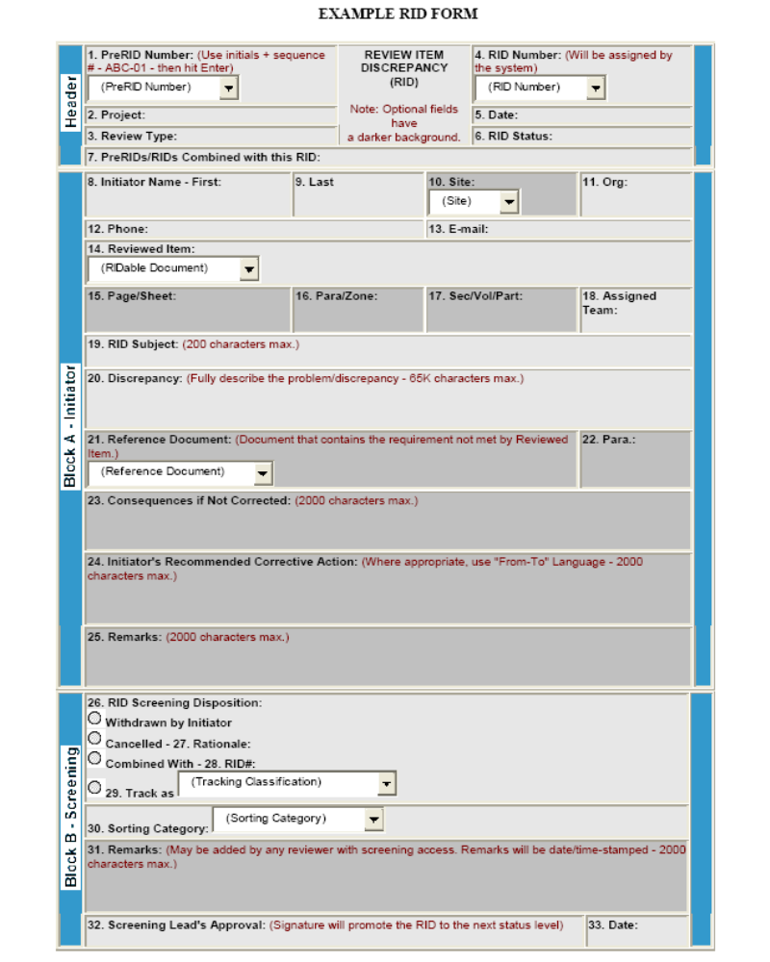
Review Item Dispositions (RIDs)
Review Item Disposition is a form used to track issues raised by reviewers with products for a review
Notes:
This is an example RID form from the Marshall Space Flight Center.
It shows many of the things you should track ina RID. Important fields include
The originator and their organization
The document being RID’ed
The issue or problem
The effect of the issue is unresolved
A resolution or disposition by the developing agency

Slide 20
Notes on RIDs
Should be specific
Should not be for typographical errors (such as spelling) or grammar unless the errors are critical to technical content
All RIDs are dispositioned
  A pre-screening board may go through the RIDs with initiators to get to preliminary resolution
  Final approval by the review board/program-project manager
At the end of the review RIDs can be dispositioned as
  Approved – which changes the product baseline
  Duplicates (many reviewers may identify the same issue)
  Withdrawn (initiator must concur)
  Disapproved – rationale must be provided (RIDs may be out of scope of project or may require a requirements change)
  Open with a forward closure plan
  Open – should be zero at the end of the review
During the RID process it is normal to track the number of RIDs in each category to determine when the final review board should meet
The cost and schedule impact of all approved RIDs must be established and budget and schedule baselines updated

Slide 21
Do you have to have RIDs ?
No
But some method of tracking issues and resolving them with initiators
  Action items, issues list, etc….

Slide 22
What Purpose Can All of These Milestones Serve ?
It is vitally important to realize that the value of the review process is identifying issues and dealing with them
Unfortunately completion of design milestones often becomes a “scorecard” for programs and projects
It is important to realize that the scorecard mentality will take place but that it is okay as long as the process continues to identify issues and deal with them
Notes:
It is easy to get into a mode where a project is score-keeping milestones. It is valid to keep track of performance but it is also important not to lose the reason why you are doing the reviews.

Slide 23
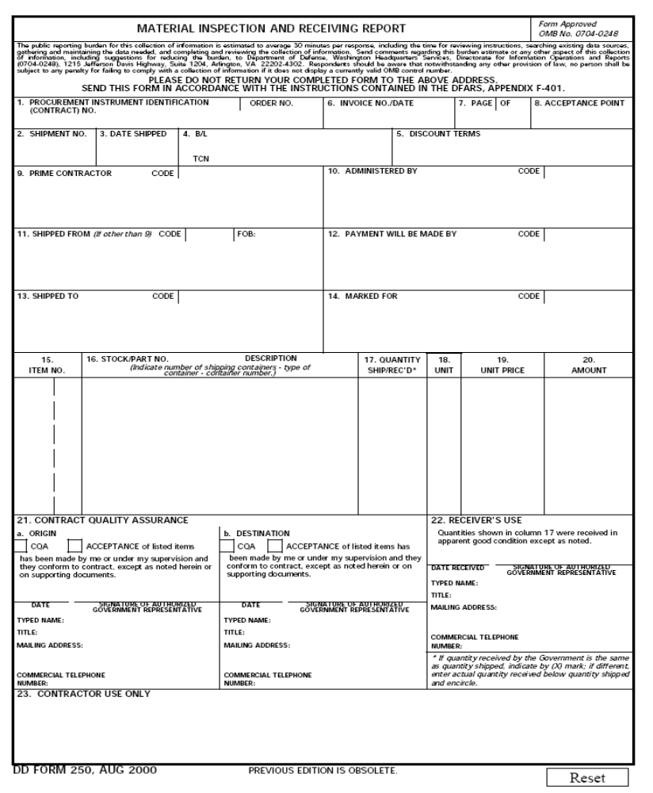
DD250
This is the form by which the government actually takes possession of a contracted item
Used by DOD, NASA
When signed off, the government has bought the item
  Indicates that the contractor has completed all of its contractual requirements
  Any further work on the item is now the government’s responsibility
  Full payment for the item is authorized

Slide 24
Any Questions ?

